Slide 1
Equation Technical Training
External Input, Enquiry API

Slide 2
Equation Technical Training
External Input
Notes:
(Use these slides as an add-on to the Universal Banking Presentation, but only to business partners and consultants.)
That concludes the presentation on Equation DBA. Now a few words about the implications for you.
We have now exposed the concepts behind Equation DBA to a large number of banks in many countries, and they have shown a great deal of interest, especially in the idea of a single integrated system covering retail and corporate banking and treasury. Using separate systems for these really does create problems with consolidated management information.
One thing on everybody’s mind is Y2000. As you know, some systems are not Y2000-compliant, and the supplier has announced withdrawal of support. In addition, many banks with in-house developed systems do not actually know whether they are compliant, and are faced with massive bills just to find out. This fact alone seems to be forcing banks to consider replacing their current systems.
Multi-currency facilities are also in demand, and the concept of relationship banking is attracting a great deal of attention.
We also see emphasis on credit risk management, and high volume retail lending as a business.
There is also a great deal of interest in branch automation, and on connectivity to alternative delivery channels.
Local customisation is clearly an issue, and with it speed of implementation.

Slide 3
External Input
External Input
allow transactions created outside Equation input system to be applied to the Equation database
2 Types of External Input
Batch external input
API - online external input
  Update APIs
  Enquiry APIs

Slide 4
External Input
Batch External Input
where a library of Equation journal files is applied
API – Online External Input
where each individual transaction is applied to Equation through an Application Programming Interface (API)

Slide 5
Equation Technical Training
Batch External Input

Slide 6
Batch External Input
Create library with duplicate journal files (KMENUL) or duplicate the required files individually
Each transaction requires 2 records (1 GYPF + 1 GZ….)
The GYPF record must contain:
  Sequence number
  Program root (first 4 chars from WMENU1)
  Transaction Type
The GZ…. record must contain:
  Sequence number (match the GYPF record)
  Image (After for add/maint, Before for cancel)
  The details of the transaction

Slide 7
Batch External Input
Apply the library
  manually via KMENUL Option 14
  automatically at start of end of day (CST0206)
  automatically at end of end of day (CST 0205)
  Clear journal after applying (CST0204)
Successful transactions flagged and so ignored if batch re-processed
Report produced of success/failures (with error messages)
Warning messages received are automatically overridden

Slide 8
Batch External Input
EQAPEXT
Apply External
Input
UTM83C
Opt.14
EQXREC
External Input
Driver
H56HMR
KINTccc/GY01LF
UTPnn
Posting Set
H56HMR
External Input
Module
UTM02C
gnnxAR
Accounting Set
UTM43C
PGM MSGQ
gnnxUR
UPDATE
Module
gnnxRR
External Input
Modules
gnnxVR
Validate Modules
KINPccc/GY01LF
KINPccc/GZgnn1
P/V Mods
KINTccc/GZgnn1
KFILccc/DATABASE
KFILccc/Code Files

Slide 9
Equation Technical Training
Online External Input/API

Slide 10
Online External Input/API
AS400
Validation
P.C.
Middleware Software
e.g. Meridian
External Input
Module
API
Update
Notes:
Example PC application is the Equation e-Banking which uses Meridian replication to input transactions from PC to EBS and vice versa.

Slide 11
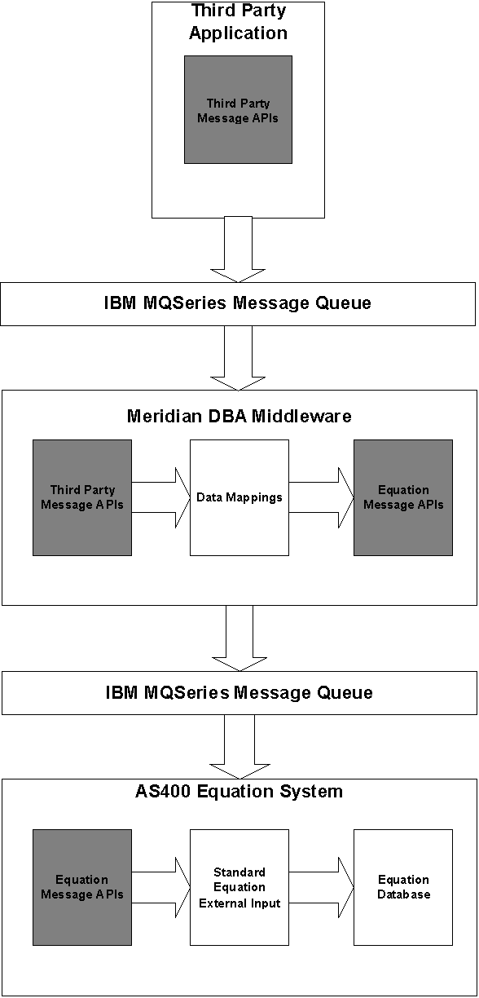
Online External Input/API
Data Flow From A Third Party Application To Equation Using Meridian Middleware

Slide 12
Online External Input/API
All update functions
Can add/maint/cancel
Call to EQUATION program H56H1R with a set parameter list
Format of transaction matches the journal record
Returned parameters
  Success/fail flag
  error message (KSMMSGF)
  up to 6 overridden warnings (KSMMSGF)

Slide 13
Online External Input/API
Parameters Required when using API
@RPGM (10) – Name of the recovery module
@BRNM(4) - Default branch mnemonic of user entering the transaction
  From DAJOBCTLE
@USID(4) – Identifier of user entering the transaction
  From DAJOBCTLE
@WSID(4) -Identifier of workstation from which the transaction is being entered
  From DAJOBCTLE

Slide 14
Online External Input/API
@JTT (1) – Journal transaction type
  A – Add M- Maintain D- Delete/Cancel
DSAIM (9999) - Details of the transaction to be entered
  In the format of the journal detail file for the transaction type being processed
@RREC(1) – Status indicator returned by the recovery module
  R – Recovered F - Failed
@RMES7(37) – Details of error messages received by the recovery module
AOW(740) – Details of up to 6 overridden warning messages

Slide 15
Online External Input/API
@ETK (4) – Enigma/TI transaction key
  A – Add M- Maintain D- Delete/Cancel
@ETN (7,0) – Enigma/TI transaction number
  In the format of the journal detail file for the transaction type being processed
@AEXT(1) – Apply during batch external input?
@AREC(1) – Apply during recovery?

Slide 16
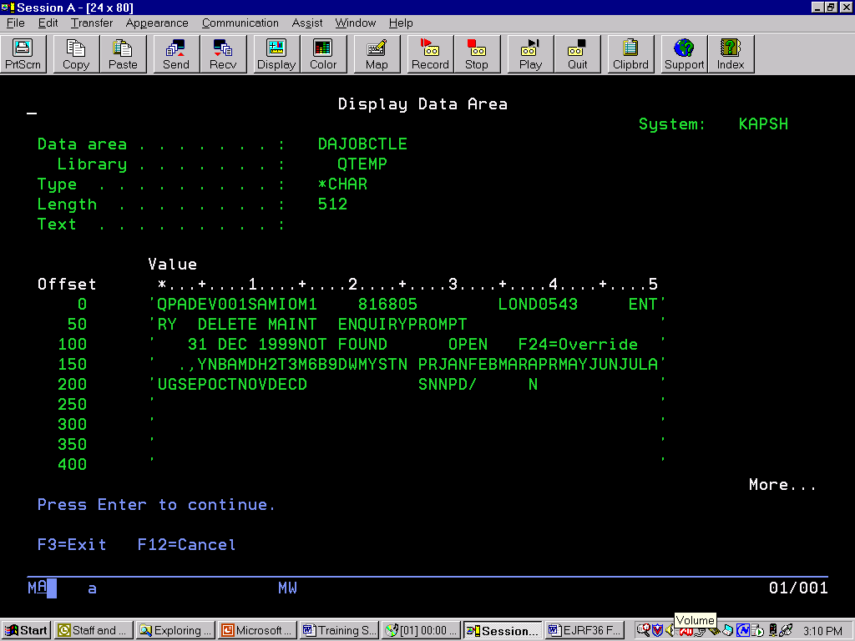
Online External Input/API
@JTT (1) – Journal transaction type
  A – Add M- Maintain D- Delete/Cancel
DSAIM (2000) - Details of the transaction to be entered
  In the format of the journal detail file for the transaction type being processed
@RREC(1) – Status indicator returned by the recovery module
  R – Recovered F - Failed
@RMES7(37) – Details of error messages received by the recovery module
AOW(222) – Details of up to 6 overridden warning messages
Notes:
This is an example of what DAJOBCTLE contains. Some data here will be used in the next slide.

Slide 17
Online External Input/API
For Example : Add Sundry Items API
@RPGM – ‘H15ARR’
@BRNM – ‘LOND’
@USID – ‘AMIO’
@WSID – ‘QPAD’
@JTT – ‘A’
DSAIM – Details of transaction (See GZH151 the necessary data needed for the transaction)
Notes:
An example system that uses API is the Payroll System which is a simple credit to an account (use ASI). Some banks receive a diskette from companies containing the employee’s account number, date the money is to be credited, etc in a text file format. Before, transactions could be entered into Equation, the text file data must first be uploaded to AS400 (E.g. new file name is Payroll).
In the API driver program, the parameters will be set up as above based o the DAJOBCTLE on the previous slide. And the transaction data will be coming from the new file Payroll. E.g. a/c number, amount, value date, etc.

Slide 18
Equation Technical Training
Enquiry APIs

Slide 19
Enquiry APIs
AS400
AS400
Main
Module
Middleware Software
e.g. Meridian
Extract
module
P.C.
A.P.I.

Slide 20
Enquiry APIs
The enquiry API facilities allow data to be extracted from the Equation database in a predefined format.
Call to EQUATION program H46HMR with a set parameter list
2 Types of Enquiry
Fixed Screen Enquiry – gnnEMR/gnnEER
Subfile Screen Enquiry – gnnDMR/gnnDER

Slide 21
Enquiry APIs
Enquiry Data Format
HZgnn1
  Pass to the extract module the key fields needed to retrieve the enquiry data
  Return the fixed format information of the enquiry
HZgnn2
  Returned containing repeating records of data, each in the format of the HZxxx2 file.
  Only used by the subfile enquiry
key fields for each enquiry are listed in the Key Details section of each enquiry format

Slide 22
Enquiry APIs
Parameters For Enquiry API
@EPGM(10) Enquiry extract prog to process request
DSAIF(3000) Fixed data format
DSAIR(3000) Repeating data format (*)
@BEGIN(1) the beginning of an enquiry? M/L flag (*)
@NOREQ(5,0) Number of records required (*)
@NORET(5,0) Number of records returned (*)
@ENQLN(2) Reserved for future use
@ERCOD(2) Error return code
@ERPRM(10) Error return parameter
Notes:
M/L flag
M = More
L = Last

Slide 23
Enquiry APIs
Parameters For Enquiry API
@FLEN(5,0) Length of returned fixed data
@RLEN(5,0) Length of single record of repeating data (*)
(*) - Used for subfile enquiries only.

Slide 24
Enquiry APIs
Fixed Screen Enquiry
Set up the following before calling H46HMR
  @EPGM(10) Enquiry extract program
  DSAIF(3000) Pass to the extract module the key fields required to retrieve the enquiry details
Returned fields
  DSAIF(3000) Fixed data format. This contains the enquiry data format HZxxx1, unless an error was detected
  @ERCOD(2) Error return code
  @ERPRM(10) Error return parameter
  @FLEN(5,0) Length of returned fixed data

Slide 25
Enquiry APIs
Sub-file Screen Enquiry
Set up the following before calling H46HMR
  @EPGM(10) Enquiry extract program
  DSAIF(3000) pass key fields required to retrieve the enquiry details
  @BEGIN(1) Is this the beginning of an enquiry? Set to Y to indicate it is the start of a new enquiry
  @NOREQ(5,0) Number of records required. This needs to be set to the number of repeating records required
Notes:
@NOREQ - This needs to be set to the number of repeating records required
E.g. number of records displayed on the subfile screen

Slide 26
Enquiry APIs
Subfile Screen Enquiry
Returned fields
  DSAIF(3000) Contains the enquiry data format HZxxx1, unless an error was detected
  DSAIR(3000) Contains multiple records of the enquiry data format HZxxx2
  @BEGIN(1) M = if there are more records
  L = if the returned records are the last
  @NORET(5,0) Number of records actually returned by the extract program
  @ERCOD(2) Error return code
  @ERPRM(10) Error return parameter
  @FLEN(5,0) Length of returned fixed data
  @RLEN(5,0) Length of a single record of repeating data, so @RLEN * @NORET = length of data returned
Notes:
@NOREQ - This needs to be set to the number of repeating records required
E.g. number of records displayed on the subfile screen

Slide 27

Write an API and ONLINE Program
EXERCISES

